Slide 1
Fundraising Strategies
For Your ReUse Program
Presented by Chris Brand
President/CEO
Friends of Disabled Adults and Children
Notes:
How?
Who ? Individuals, businesses, and agencies – drop off at our Tucker office or if 10 systems or more pick up is considered
To help defray the recycling costs

Slide 2
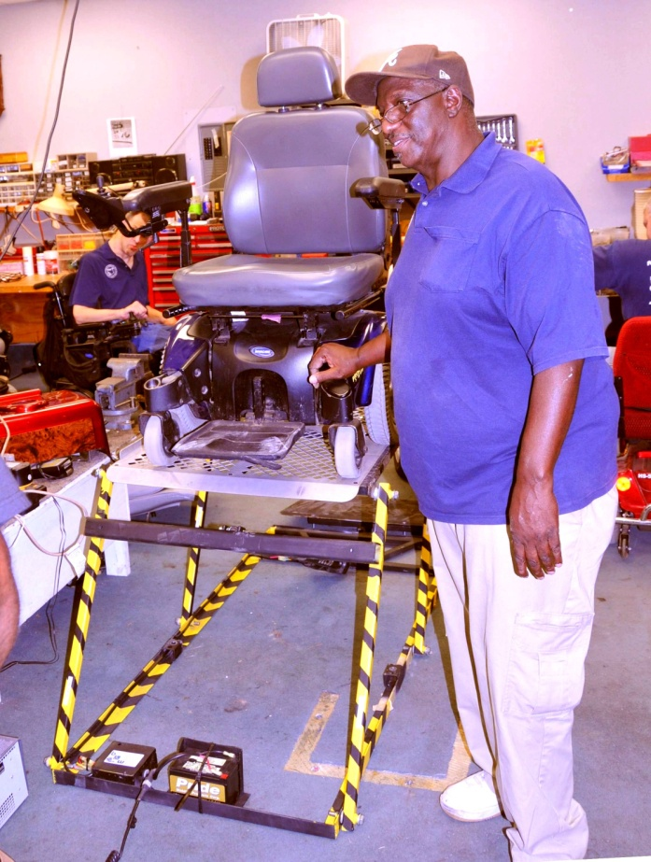
Friends of Disabled Adults and Children
Home Medical Equipment
HME repair program
Home & Vehicle Modification
Assistive technology, independent living aids and computers
www.fodac.org
Notes:
How?
Who ? Individuals, businesses, and agencies – drop off at our Tucker office or if 10 systems or more pick up is considered
To help defray the recycling costs

Slide 3
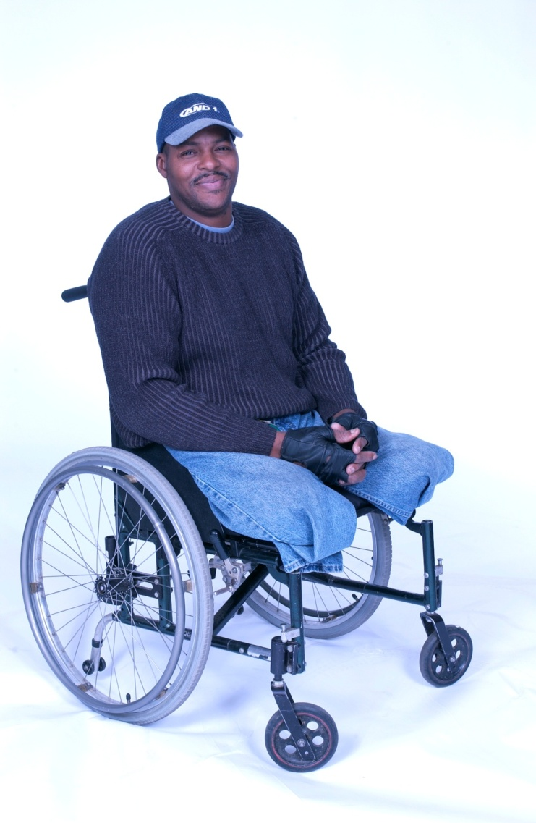
Friends of Disabled Adults and Children
Since 1986 supporting:
All ages & injuries
Local hospitals & clinics.
Disability groups
Nursing home transition
Emergency Preparedness ,Recovery and Mitigation
www.fodac.org
Notes:
How?
Who ? Individuals, businesses, and agencies – drop off at our Tucker office or if 10 systems or more pick up is considered
To help defray the recycling costs

Slide 4
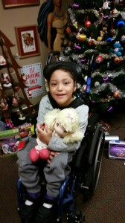
Friends of Disabled Adults and Children
65,000 sq. ft. Warehouse/Offices
(2) 20’ Box trucks
$1,282,000 Operating Budget
Over $10M in Retail Value given
Under 5% Overhead
4 Star Charity Navigator
www.fodac.org
Notes:
How?
Who ? Individuals, businesses, and agencies – drop off at our Tucker office or if 10 systems or more pick up is considered
To help defray the recycling costs

Slide 5
Plan for Sustainability
Institutionalize program/organization and open the door to Foundations
Growth of capital to increase access/delivery of AT/HME
Goal of 1/3 Govt., 1/3 Self Generated, 1/3 Other income sources for balanced growth
DIVERSIFY

Slide 6
Setting the Foundation
Financial Statements
Audit
Charity Navigator
990 - % of Overhead
Budgets – Budget to Actual
Strategic or Business Plan
Developing the Board and Advisory Boards

Slide 7
2015 contributions: $373.25 billion by source (in billions of dollars – all figures are rounded)
Source: Giving USA Foundation 2016

Slide 8
2015 contributions: $373.25 billion by type of recipient organization (in billions of dollars – figures are rounded)
Source: Giving USA Foundation 2016

Slide 9
Changes in giving by source 2013−2014, 2014−2015, and 2013−2015 (in inflation-adjusted dollars, 2015 = $100)
Source: Giving USA Foundation 2016

Slide 10
Fundraising Goals
INCOME | Actual |  | Capital Only
Corporations |  | $89,639
Foundations |  | $219,333 | $85,000 | $304,333
Government
DeKalb County | $27,500
DCA | $14,540
GA Budget | $30,000
ARC-MFP | $104,439
Fulton Co. | $35,000
Other | $93,351
Total Government |  | $304,830
Individuals |  | $141,371
Organizations |  | $38,267
Other earned income | $24,038
remount | $10,625
dme client repair fees | $54,830
vehicle sales | $10,974
battery purchases | $52,076
Total earned income |  | $152,543
Thrift Store Sales |  | $257,533
TOTAL INCOME |  | $1,283,516 | $85,000 | $1,288,516

Slide 11
Fundraising
Individuals
Annual Fund
Online giving – Digital Media
Special Events
Bequests
Stock

Slide 12
Individual Giving
Use Social Media / Blogs / Pictures / Stories
Events / Tours
Annual Campaign / Direct Mailing
GA State Merit Campaign
Combined Federal Campaign “Under 5% Overhead” Federation
Friend Raising / Board Development
Estate Planning

Slide 13
Individual Giving
Contact – Cultivate
Demonstrate Leadership – Partnerships
Good Reporting of Outputs/Outcomes
Satisfaction Surveys
Get Rated by Charity Navigator (4 stars)

Slide 14
Preferred Giving Channels
Online is now the top preferred method of donation, eclipsing mail . . .
Source: Grizzard’s DonorGraphicsTM media usage study, 2014. Base: US Donors (online adults who are 12-month active donors) (n=1,531).
Notes:
People may not always react the way they think they will act. AUDIENCE – active online donors

Slide 15
Maximizing Digital Strategy & Impact…
5 email solicitation series focused on the matching grant & created urgency to give at year-end
Homepage banner was added into current rotating banners (1st position)
A light box with a pop‐up feature that activated as soon as the homepage was loaded. ..a short call to action, requesting a donation and mentioning that the gift would be doubled
Facebook posts were focused during December

Slide 16
Help Deliver Hope, Independence and Freedom Digital Campaign
$30,000 Matching Gift, from a Foundation
$24,000 from digital friends
$10,000 Match from a 2nd Foundation
Facebook posts
Total $64,000

Slide 17
Matching Gift Digital Campaign Light Box

Slide 18
Matching gift +5 emails + Light Box=$62,419.00

Slide 19
Facebook Post

Slide 20
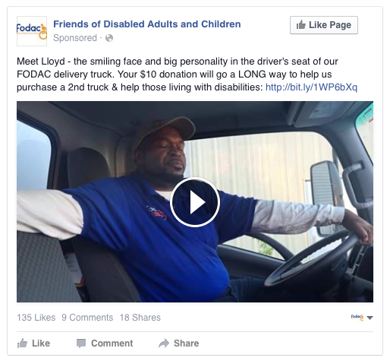
Facebook Video

Slide 21
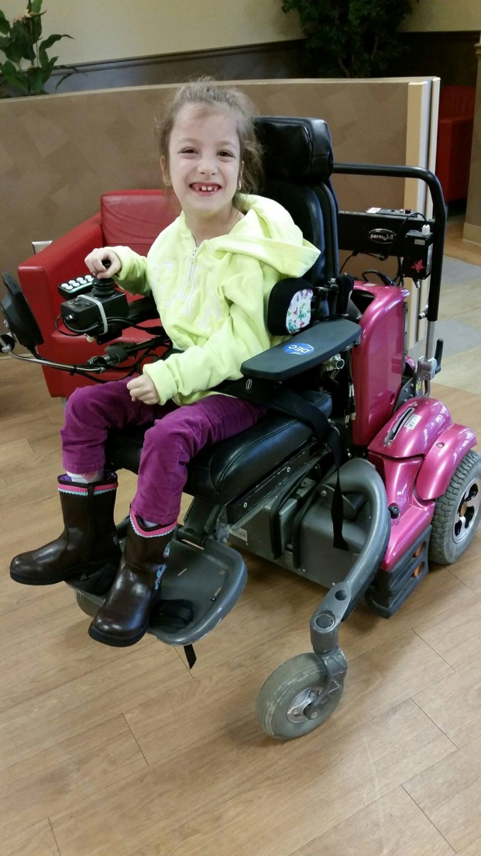
Meet Selin!
“Meeting the needs of a mobility-impaired child can seem overwhelming to the caregiver,” states Chris Brand, CEO of FODAC.
“The quantity and cost is compounded by having to constantly upgrade that equipment as the child grows. We are grateful for grants, which will help these children engage more fully in home, school and community life.”

Slide 23
Fundraising
Foundations
Programmatic Funding
Capital Funding
Training – Consulting
Endowments

Slide 24
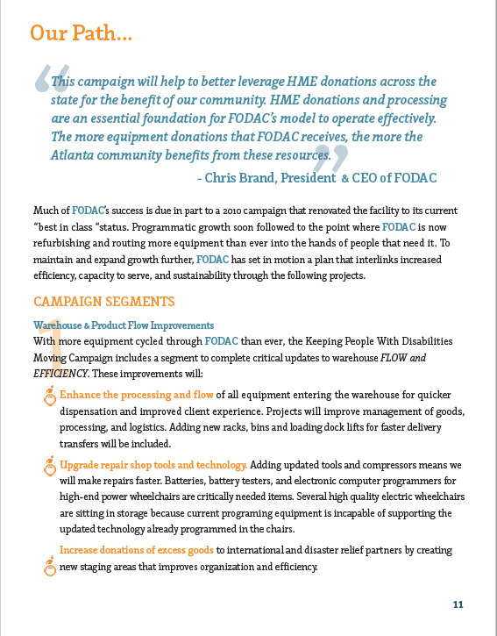

Slide 25
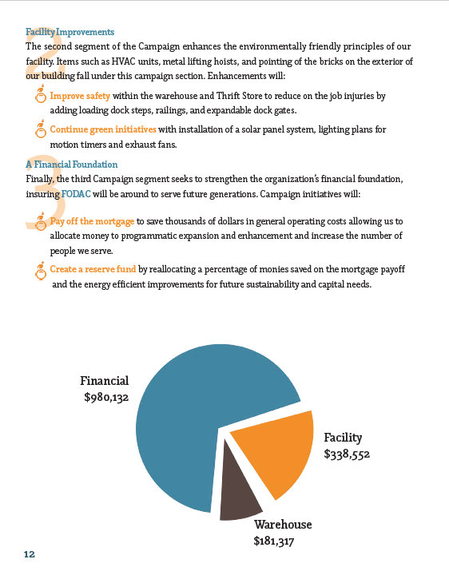

Slide 26
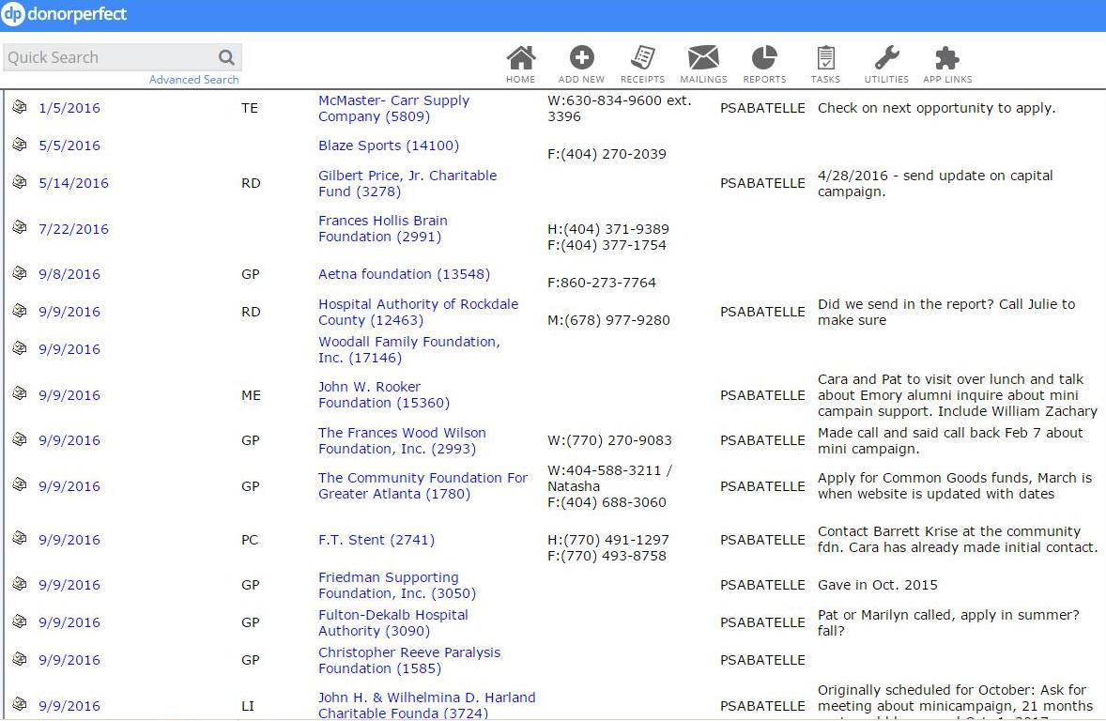

Slide 27
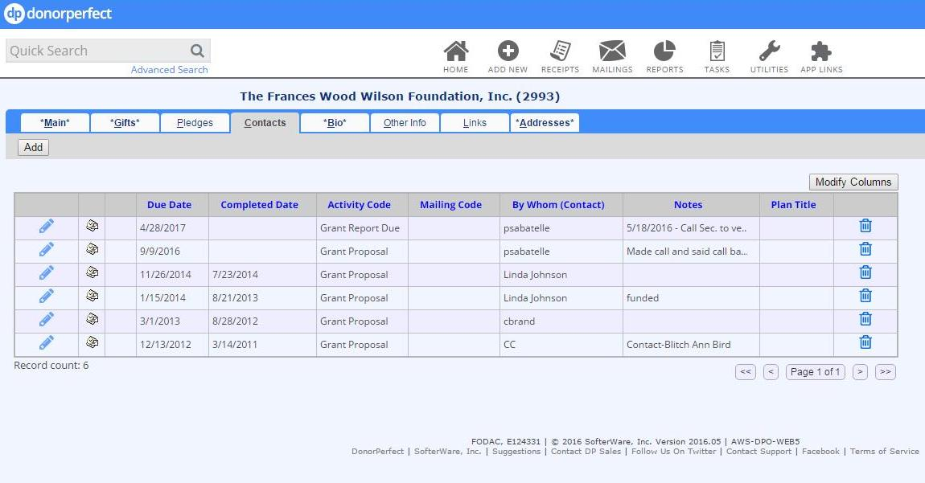

Slide 28
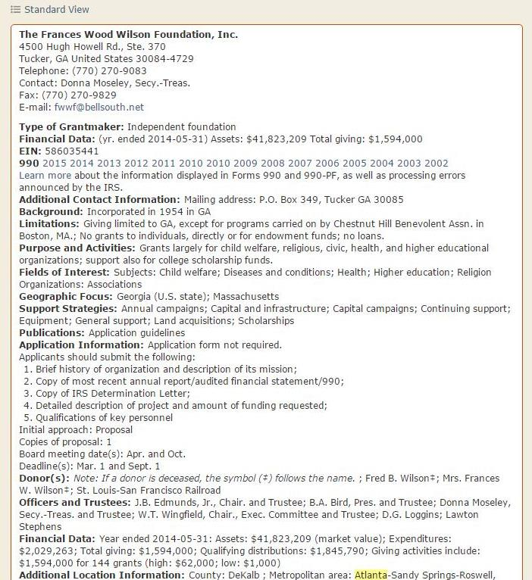

Slide 29
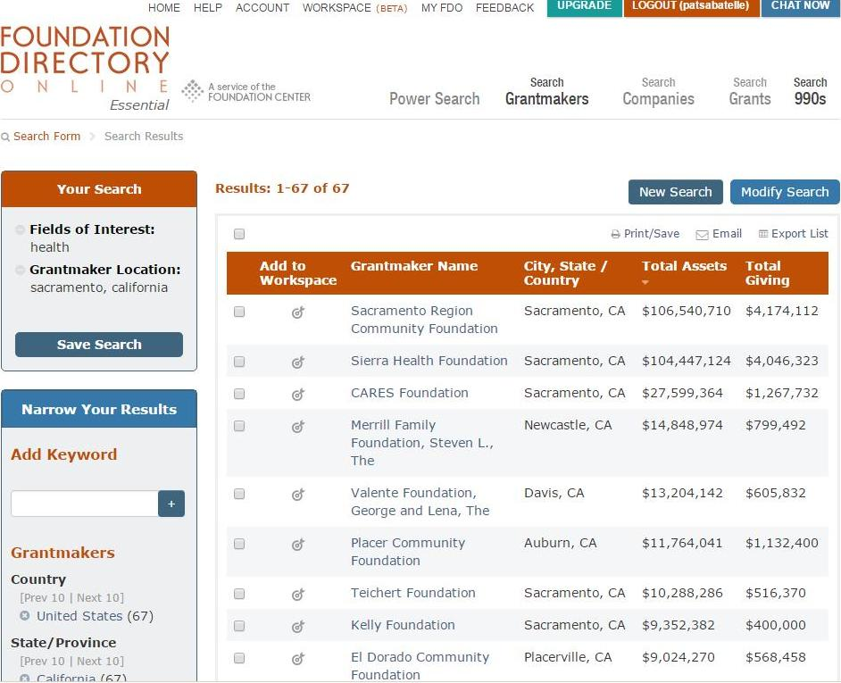

Slide 30
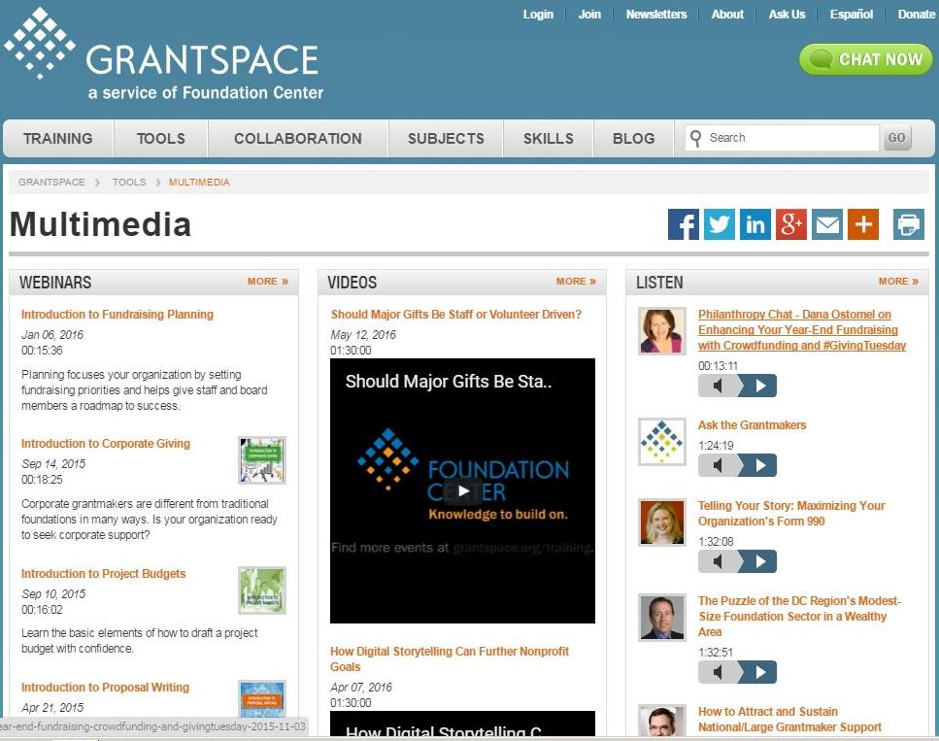

Slide 31
Formulas for Funding ReUse
Use cost allocation to show the need for targeted funding sources
Ex: Children’s DME costs are $41,000 and you use this to show what your budget is for this potential funder
Grant may ask for them to contribute $10,000 toward this program budget.

Slide 32
Formulas for Funding ReUse
Use cost allocation to show the need for targeted funding sources
Ex: Divide the number of items provided by the total of operating cost for the program to get the cost to provide each item.
Do an average hourly time estimate to refurbish/process each item to do an estimated cost to provide each item.

Slide 33
Fundraising
Earned Income
Fees for Service to Clients
Auto Sales
Thrift Store – selling donated items

Slide 34
Earned Income
Registration Fees $25
Hard Costs – New Items such Batteries, Ramps and other DME (Rotary/Disaster)
Repair Service Fee $25
Repair Per Item - Varies

Slide 35
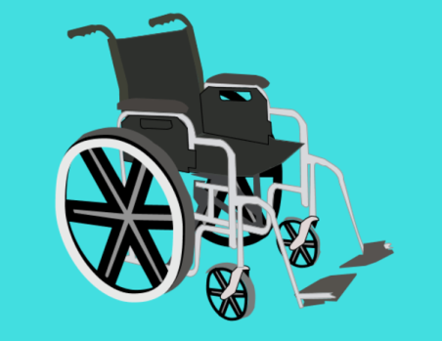
Fees For Services
Sanitizing Fee $15
Tires/Drive Wheels $10
Tubes $5
Small Tires $5
Footrests $15
Armrests $5
Upholstery/seating $20
Charger $25
Joy Stick $30
Casters $5
Motors $30

Slide 36
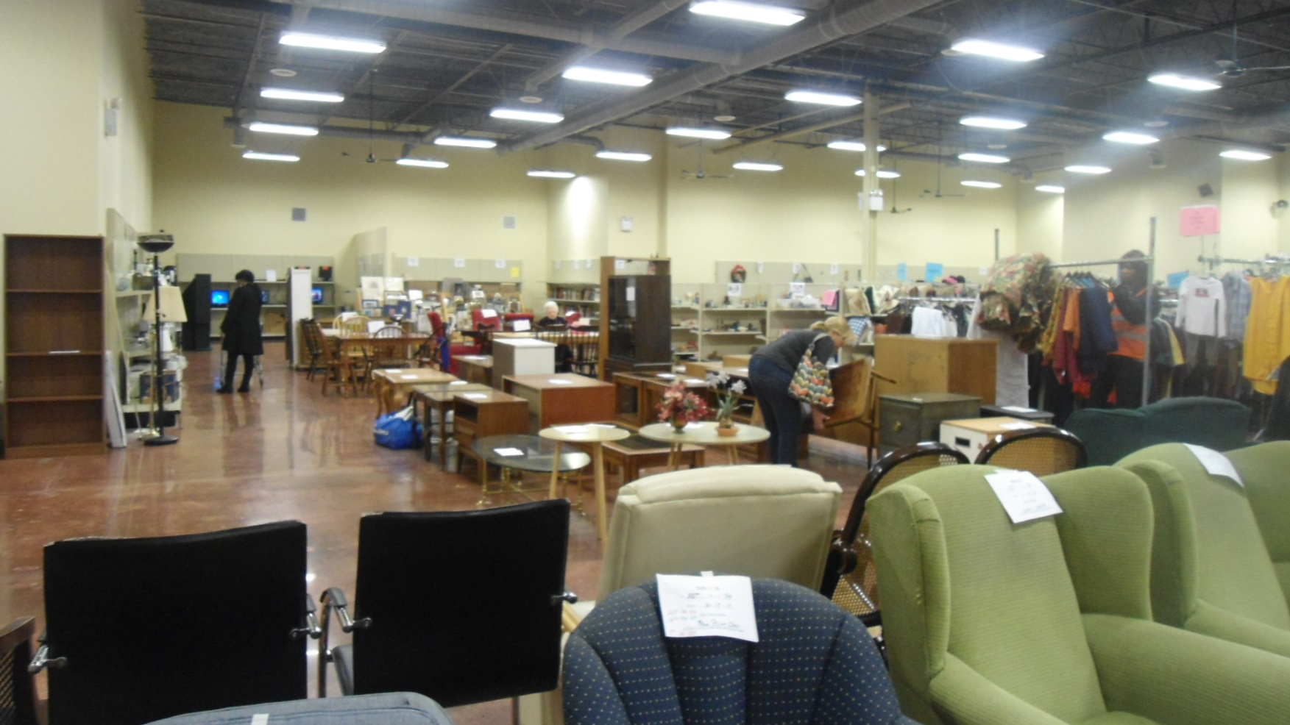
FODAC Thrift Store

Slide 37
How can you help FODAC?
It’s tax deductible!!
Donate
to the
FODAC Thrift Store
Choose FODAC to receive your
Gently used house hold items
Furniture Dishware's
Clothing/shoes Flat screen TV’s
Books Appliances
Jewelry Knick Knacks
Schedule a pickup of your larger items at 770-492-9014 ext. 114
Or
Drop off at our facility: 4900 Lewis Road
Stone Mountain, GA 30083
Monday – Friday 9:30-5:00
Saturday 10-4

Slide 38
Fundraising
Corporations
Corporate Foundations
Volunteer groups
Special Events
In-Kind

Slide 39
Join us for our Run, Walk, and Roll at Stone Mountain Park First Saturday in May
Event Emcee Doug Turnbal Traffic reporter from WSB 2015
A great day of support and Fun!!

Slide 40
Breakfast with Santa Come join us this year December 10th at Stone Mountain Park Marriott at 9 am

Slide 41
FODAC’s
Annual Golf Tournament
Wednesday October 12, 2016

Slide 42
Fundraising
Organizations
Places of Worship
Service Clubs: Rotary, Frat Order of Eagles, etc.
Paid Partnerships: Hospitals, Delivery
Disaster Relief

Slide 43
Partnerships - Organizations
Other Non-Profits
Places of Worship
Centers for Independent Living
AAA – ADRC’s
Hospitals
Rotary / International Service
Disaster Relief – GEMA FEMA

Slide 44
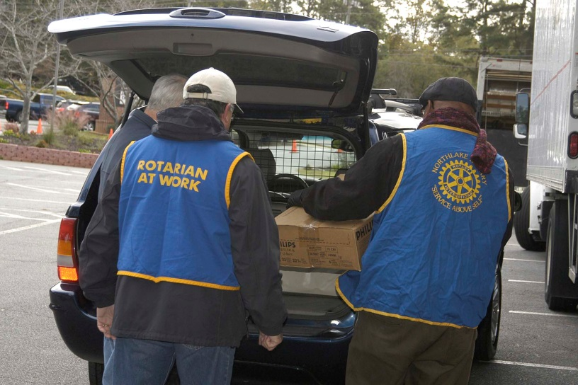
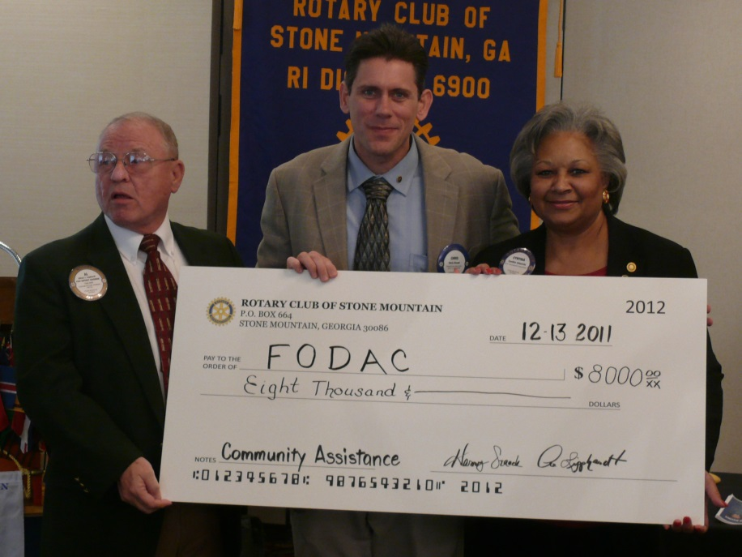
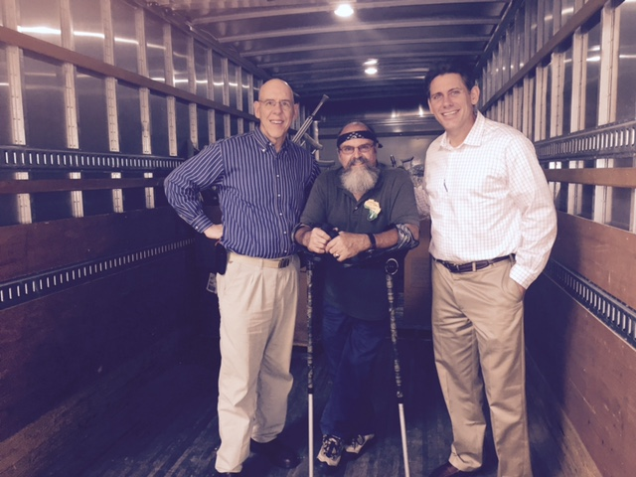
Rotary Club Partners
Rotary Clubs in Georgia have partnered with FODAC to hold equipment drives and fundraisers.

Slide 45
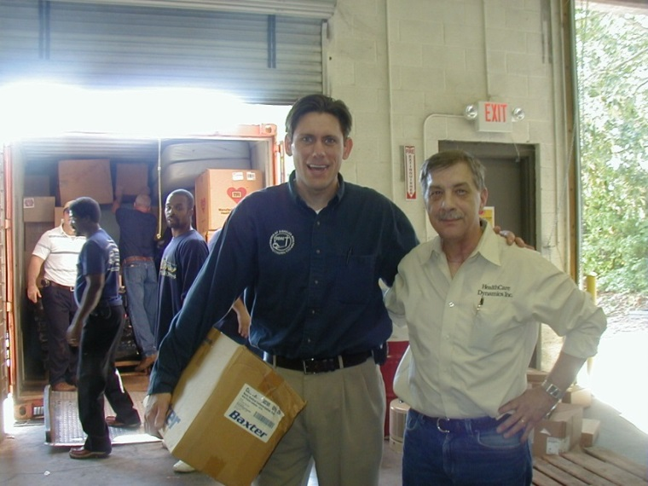
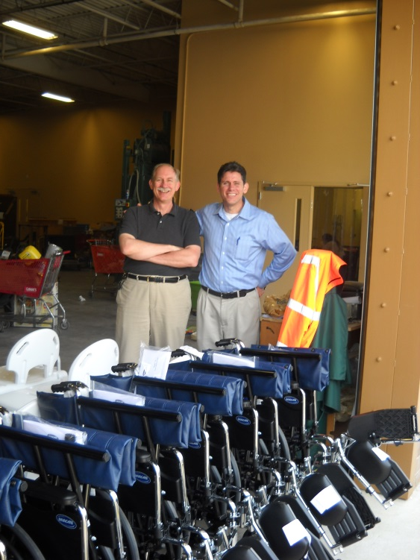
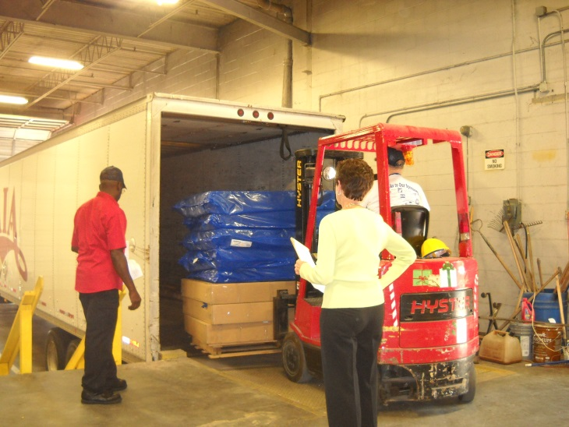
International Partners
International partnerships. FODAC works with other partners who specialize in International relief. We provide excess HME, items we cannot locate locally, and items our clients cannot use.

Slide 46
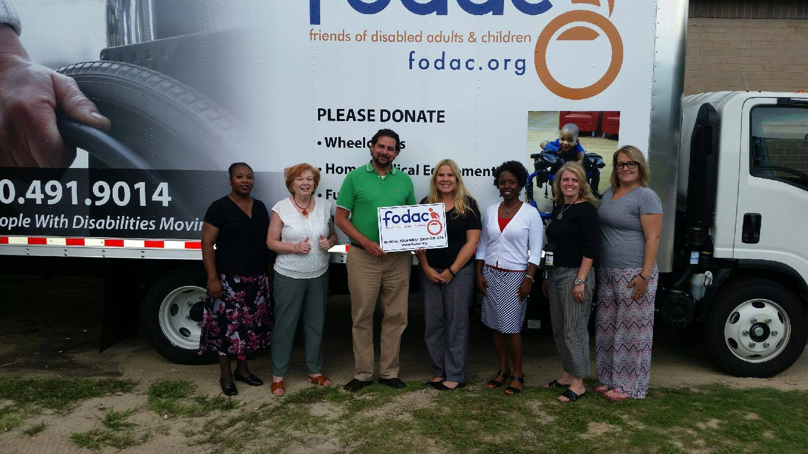
We’re excited to announce a new partnership with the AAA and ADRC in Darien, GA! Not only are these now official FODAC drop-off locations, but this partnership means we’ll deliver much-needed equipment to those living South of Savannah 4-5 times per year. We’re thrilled to expand FODAC’s reach and help make someone’s life just a little bit easier.

Slide 47
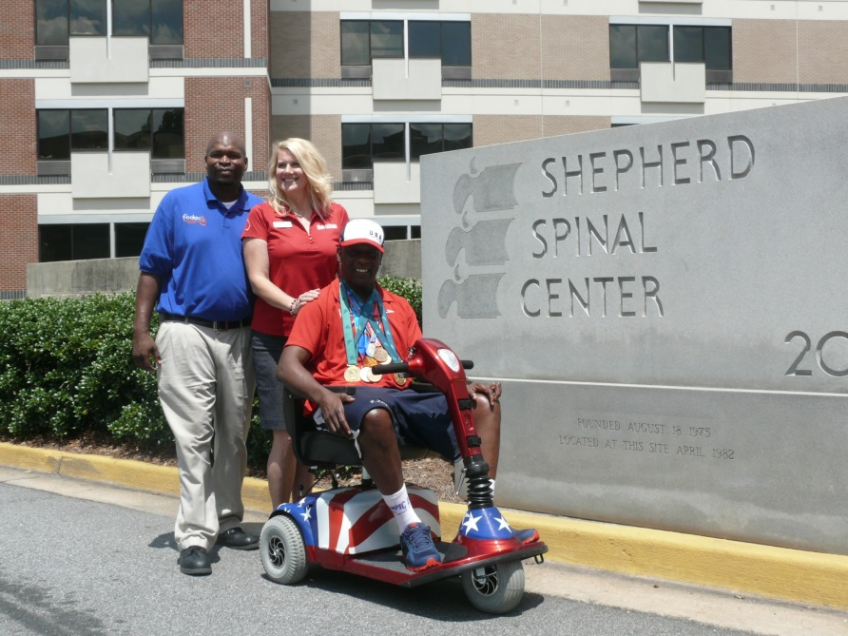
Hospital Partnerships
Grady Hospital
Rockdale Medical Center
Shepherd Center
Delivering HME to our Hospital Partners on a monthly basis.
Allows hospital to send indigent patient’s home with equipment they need to make a fast and safe recovery.
Nominal cost for the hospital

Slide 48
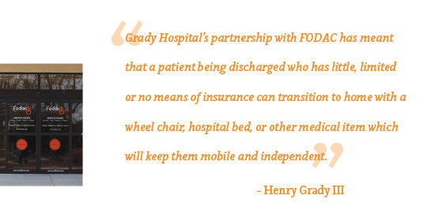
Hospital Partnerships
Grady Hospital

Slide 49
Fundraising
Government
County, CNBG funds
State Budget, Depts., Medicaid
Regional Commission, MFP
State merit, Combined Federal Campaign
Federal, ACT, AT Act

Slide 50
If you don’t document, you didn’t do it!
Client Database
Client testimonials
Outputs
Retail Value
Outcomes – Survey Results
Demographics
Location, county, zip, census tract
Reporting

Slide 51
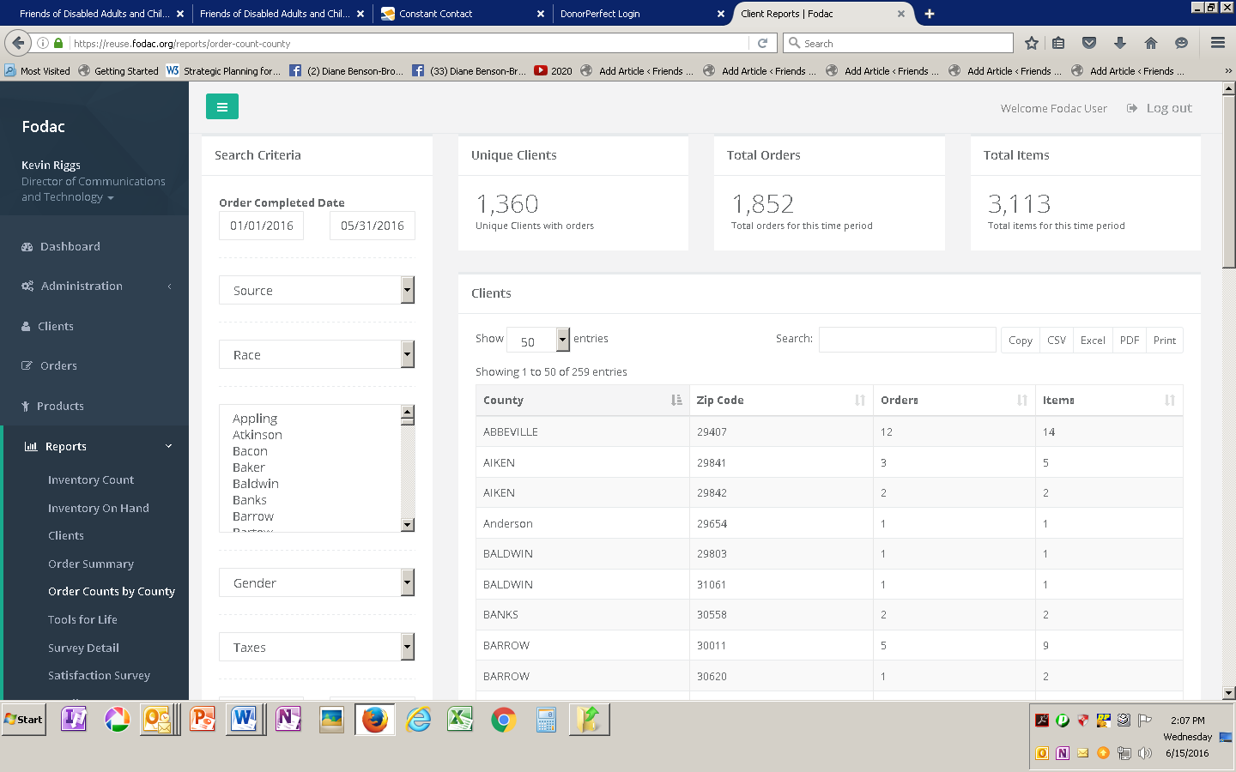

Slide 52
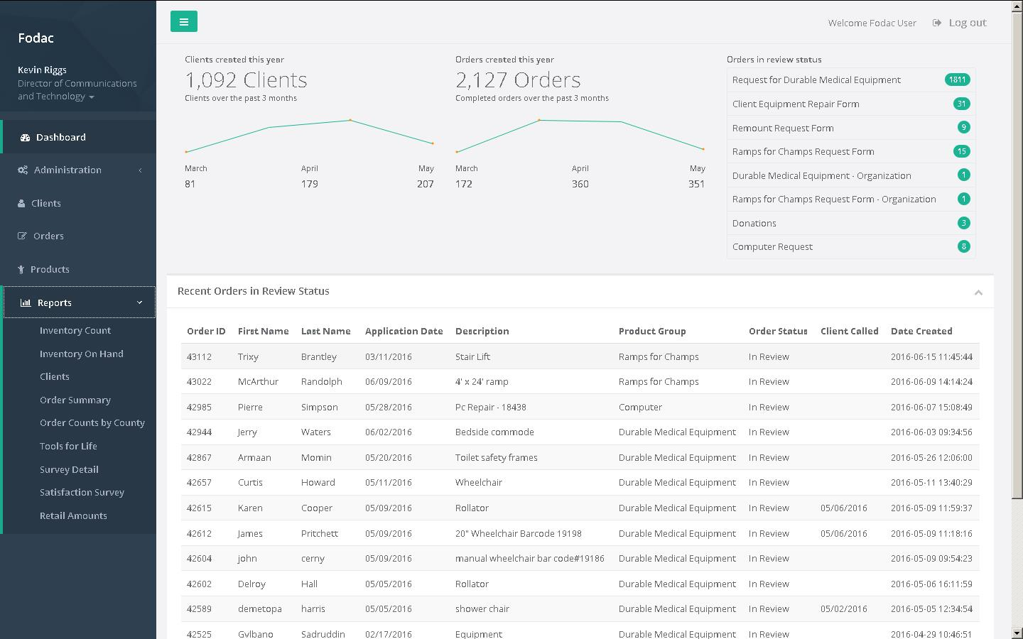

Slide 53
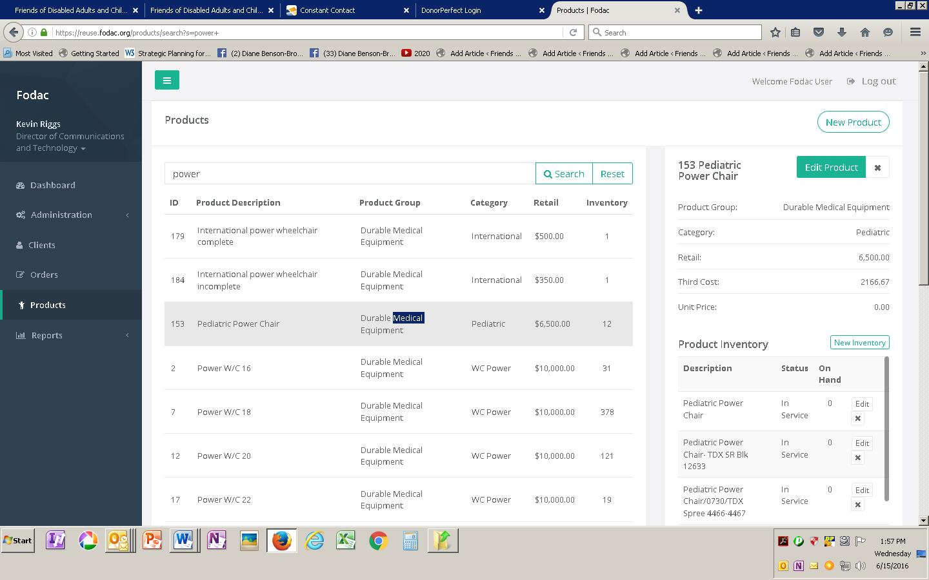

Slide 54
Friends of Disabled Adults and Children, Too! Service Outcomes
5,026 Home Medical Equipment items were provided in Georgia, fulfilling 4,563 separate requests.
215 HME items outside Georgia were provided to 171 clients in 10 states and 2 countries
2,223 unique clients from Georgia have received direct service at least once.

Slide 56
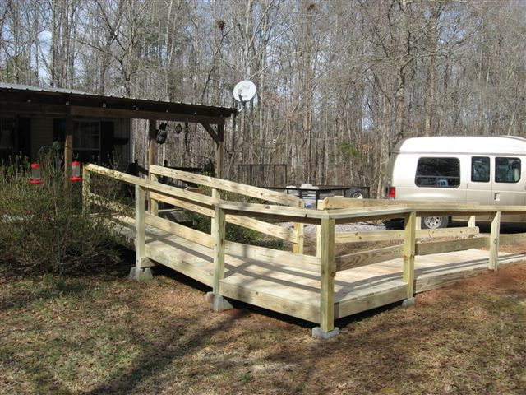
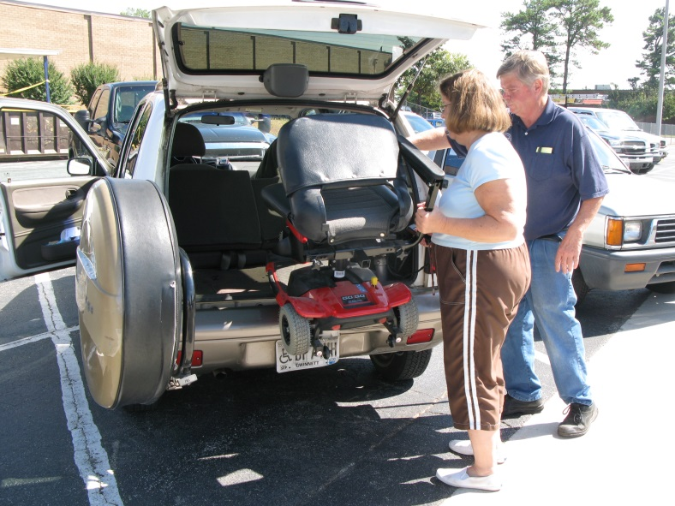
Home & Vehicle Modifications
28 Home Modifications
48 Vehicle Modifications

Slide 57
Friends of Disabled Adults and Children, Too! Service Outcomes
76 people were able to go to work
724 were able to go to the doctor
190 were able to go to school
74% could not afford to purchase the items
83% were “very satisfied” with services provided

Slide 58
Friends of Disabled Adults and Children (Fodac)Select Satisfaction Survey Comments:
“We take our special needs children to Disney World every Christmas. The Hoyer lift will enable us to move the children in and out of the motor home without endangering our aging backs”
“He has been confined to his bed since he was shot multiple times in June,2012. This chair will allow him to be able to come and sit down stairs with the children who will be coming to visit for Christmas. The chair will also provide him with a way to sit outside and enjoy the yard”.
“They have helped my grandson so much. He had spinal surgery and FODAC have been a real helping to us and I really appreciate them and I always refer everybody to FODAC. They are The Miracle forever.”
“Lay Htoo Shee is a very active little girl trapped in a body that simply will not cooperate with her wishes! This chair will allow her the flexibility/mobility to negotiate within her environment at home school on the playground and anywhere else her will takes her.”
“This will save me a lot, Thanks, This is a blessing for my family. I don't take a day off for 1 year. Now I feel I can take a day off for myself. Thanks a lot”.
“It allows me independence and ability to recover from gall bladder, appendix, and 3 level spine fusion and also manage my scoliosis which will forever be a chronic illness of mines. Its helped change my life.

Slide 59
Let’s Recap
Networking! Develop relationships with Foundations, Fundraising consultants, Mentors
Fees for service to access HME, repairs,
Consider Capital campaigns or Capital renovation campaigns

Slide 60
Keep in Mind
Be sure to give any major donor a report on how their money was used whether they ask for it or not
Take a Board member with you to any major request with individuals or site visits
Be aware of etiquette – listen to their passions
Networking-help others (they will help you!)
Do no harm telling your story
Prioritize funding needs

Slide 61
Community Resources
http://foundationcenter.org/sanfrancisco/resources.html
Technical Assistance Providers
Service Organizations and Associations
Consulting, Training, and Resources
Legal and Accounting Services
Loans, Meeting Space, Real Estate, and Renovation
Academic Programs
Computer Technology
Employment Resources
Resources for Artists and Nonprofit Arts Organizations

Slide 62
SERVICE ORGANIZATIONS AND ASSOCIATIONS
Association of Fundraising Professionals Golden Gate Chapter 3871 Piedmont Ave. PMB 24 Oakland, CA 94611 Tel: (415) 404-6501 Email: admin@afpgoldengate.org
Professional association for fundraising executives offering continuing professional education, career development, a mentoring program, a newsletter, and Fund Raising Days.
California Association of Nonprofits 400 Montgomery Street, Suite 500 San Francisco, CA 94104 Tel: (800) 776-4226 Fax: (866) 731-1672
The California Association of Nonprofits (CalNonprofits) is a statewide membership organization that brings nonprofits together to advocate for the communities we serve.
Development Executives Roundtable Email: administrator@dersf.org
Development Executives Roundtable (DER) is an educational and collegial resource for Bay Area fundraisers – professional, volunteer, and potentials alike – for over 35 years. Lunchtime meetings held on the second Friday of every month (with rare exceptions).
Grant Professionals Association (GPA)
Since its inception in 1998, GPA has grown rapidly. With over 1,800 current members internationally, the opportunities and benefits of membership continue to attract people from all over the globe.

Slide 63
Harvard Business School Community Partners Tel: (650) 799-9365 Email: info@hbscp.org
HBS Community Partners offers Bay Area nonprofits the opportunity to have pro bono consulting and advisory services by Harvard Business School alumni who wish to channel their business management skills to create positive social impact.
Net Impact
Net Impact's Service Corps volunteers partner with nonprofits on short-term, part-time consulting projects related to finance, marketing, new program development, business planning, fundraising, and strategic planning.
Northern California Grantmakers 160 Spear Street, Suite 360 San Francisco, CA 94105 Tel: (415) 777-4111 Fax: (415) 777-1714
Northern California Grantmakers (NCG) is an association of foundations, corporate contributions programs and other private grantmakers. NCG's work is focused in two broad arenas: enhancing the effectiveness of philanthropy, and strengthening the ties between philanthropy and it many stakeholders in nonprofit organizations, government, business, media, academia, and the public at large.
Stanford Alumni Consulting Team Stanford Graduate School of Business 655 Knight Way Stanford, CA 94305 Tel: (650) 736-1956 Fax: (650) 723-5151
The Stanford Alumni Consulting Team provides pro bono consulting expertise in a wide range of areas, including strategic planning, marketing, earned revenue, financial sustainability, and organizational growth.
Young Nonprofit Professionals Network-San Francisco Bay Area The Young Nonprofit Professionals Network-San Francisco Bay Area (YNPN-sfba) promotes an efficient, viable, and inclusive nonprofit sector that supports the growth, learning, and development of young professionals.

Slide 64
CONSULTING, TRAINING, AND RESOURCES (Also check with area colleges and universities and their continuing education centers for additional opportunities.)
Association of Fundraising Professionals Golden Gate Chapter
Web site provides a directory of consultants.
Center for Nonprofit Management Southern California 1000 N. Alameda Street, Suite 250 Los Angeles, CA 90012 Tel: (213) 687-9511 Fax: (213) 687-7159 Email: main@cnmsocal.org
The Center for Nonprofit Management offers seminars on issues related to nonprofit management.
Center for Volunteer and Nonprofit Leadership of Marin 65 Mitchell Blvd., Ste. 101 San Rafael, CA 94903 Tel: (415) 479-5710 Fax: (415) 479-9878 Email: info@cvnl.org
Offers a series of workshops and trainings, affinity groups, a resource library, and a referral service for volunteers to the Marin nonprofit and volunteer community.
CompassPoint Oakland Office and Convening Space 500 12th Street, Suite 320 Oakland, CA 94607 Tel: (510) 318-3755 Fax: (415) 541-7708
CompassPoint Nonprofit Services is a nonprofit consulting and training organization. They provide nonprofits with the management tools and concepts necessary to best serve their communities.
Consulting Within Reach 2570 N. 1st Street, Suite 251 San Jose, CA 95131 Tel: (408) 916-3734 Email: info@cwr-team.com

Slide 65
Consulting Within Reach provides consulting to nonprofits in the San Francisco Bay Area, Los Angeles, and beyond. We are a White House award winning firm with services in strategic planning, marketing, fundraising, database, and web.
iReuse 1050 North Gate Drive, Suite 550 San Rafael, CA 94903 Tel: (415) 924-9977 Email: info@ireuse.com
iReuse is a service in the Bay Area helping nonprofits, schools, and other organizations get the stuff they need. All you need to do is create your wish list on iReuse's web site and get automatically matched up with local businesses and residents who are donating items which meet your needs.
Mary's List Email: info@maryslist.net
Mary's List was created by Mary Gregory, a program officer at Pacific Foundation Services, as a way for non-profits to connect with qualified consultants and for consultants to connect with each other.
The Impact Foundry 4700 Roseville Road, Suite 211 North Highlands, CA 95660 Tel: (916) 569-8555 Fax: (888) 550-6772 Email: info@nprcenter.org
The mission of the Impact Foundry is to enhance the resources and improve the management of nonprofit organizations, primarily within California’s northern Central Valley and Sierra Nevada regions.
Nonprofit Roundtable Free seminar series sponsored by four consulting firms. Each sponsor offers training sessions on their specialty to the nonprofit community or brings in experts to cover topics of interest.
The Taproot Foundation 466 Geary Street, Suite 300 San Francisco, CA 94102 Tel: (415) 359-0226
The Taproot Foundation is a leading nonprofit marketing and technology consulting firm. The foundation's work is offered pro bono in a competitive grantmaking process.

Slide 66
Volunteer Center of the East Bay 700 Ygnacio Valley Rd. #140 Walnut Creek, CA 94596 Tel: (925) 472-5760 Tel: (510) 232-0163 Fax: (925) 472-5780
The Volunteer Center operates with the mission of linking people who care with people in need.
Volunteer Center of San Francisco 1675 California Street San Francisco, CA 94109 Tel: (415) 982-8999 Fax: (415) 982-0890 Email: info@thevolunteercenter.net
Volunteer Center serves as a clearinghouse of volunteer information for San Francisco nonprofit organizations, individuals, city agencies, and other civic groups.

Slide 67
Questions?
Chris Brand
President/CEO
Friends of Disabled Adults and Children
770 491-9014 ext. 111
866 977-1204
http://www.fodac.org/video/premier-cares-video/
Facebook - Twitter
“Keeping People With Disabilities Moving”
www.fodac.org
chrisbrand@fodac.org

